Slide 1
3rd Technical Workshop
Theme:
Transparency & Accountability and Monitoring and Evaluation
Prof Christmal Dela Christmals
North-West University

Slide 2
PRESENTATION FOCUS
Background
1
Focus
2
Paradox of NHI accountability
3
A call to advocacy
4

Slide 3
Background

Slide 4
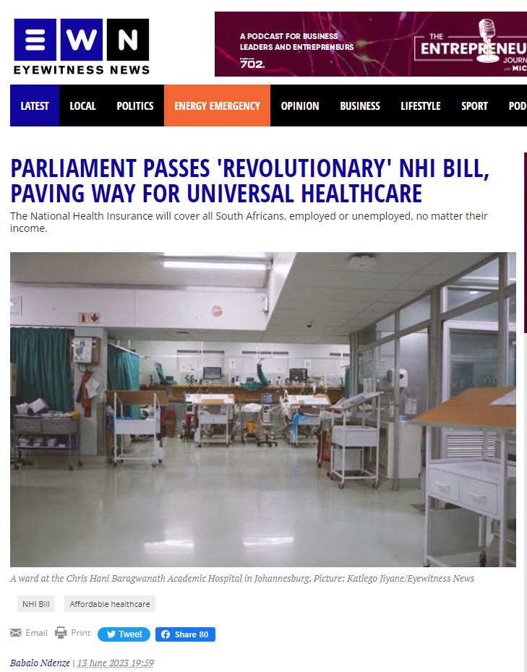
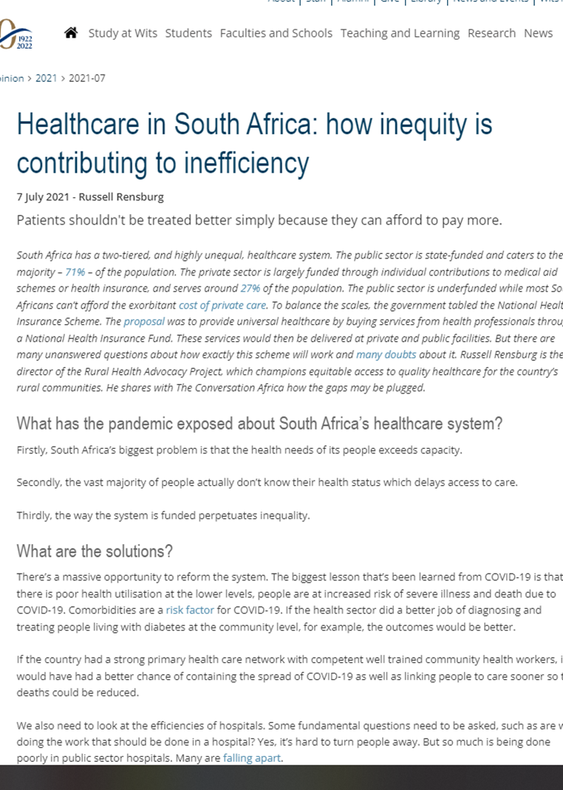
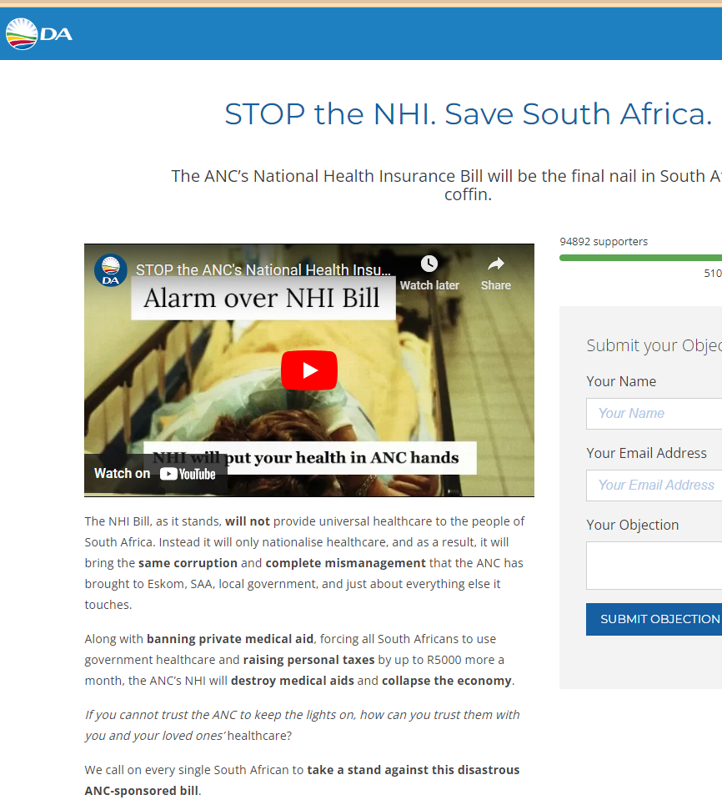
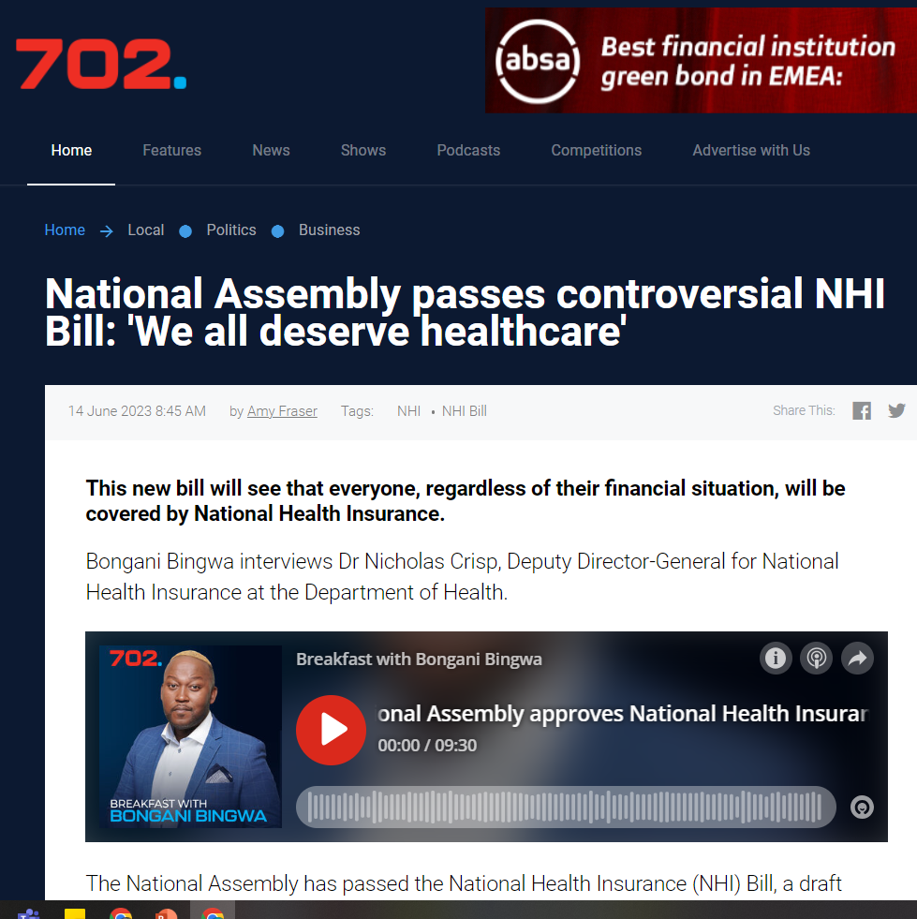
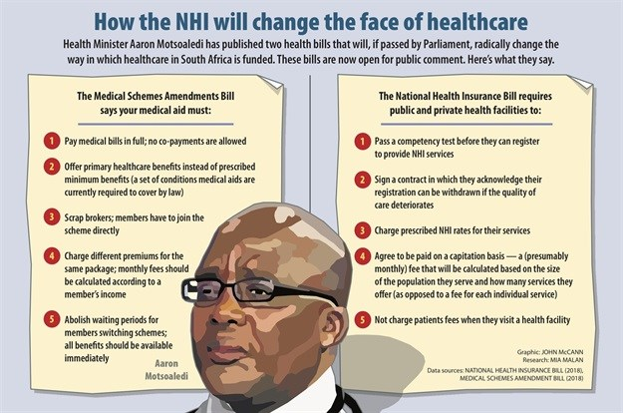
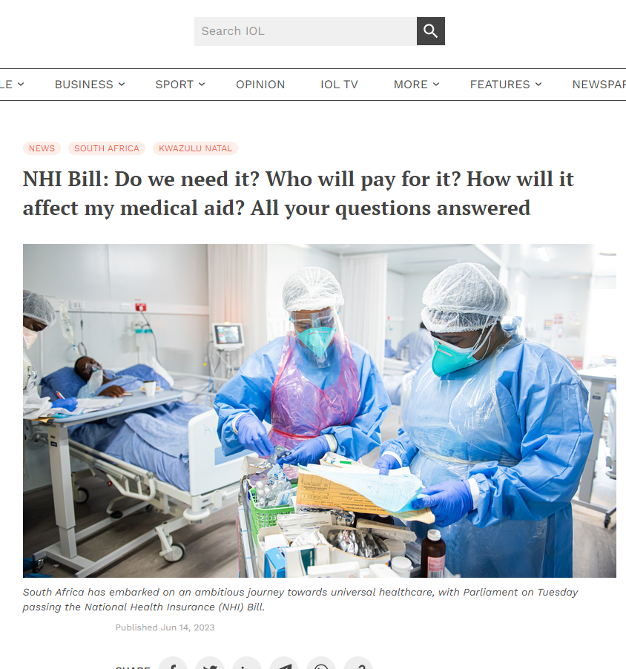
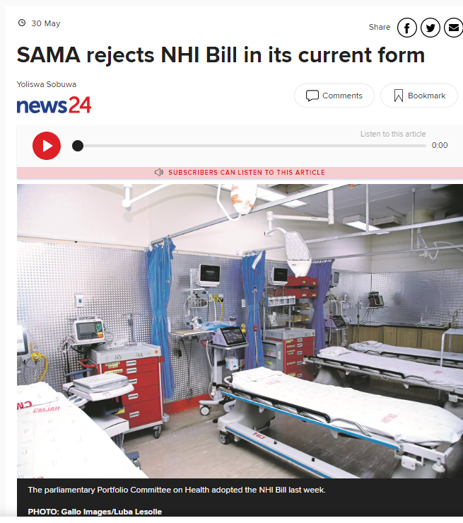

Slide 5
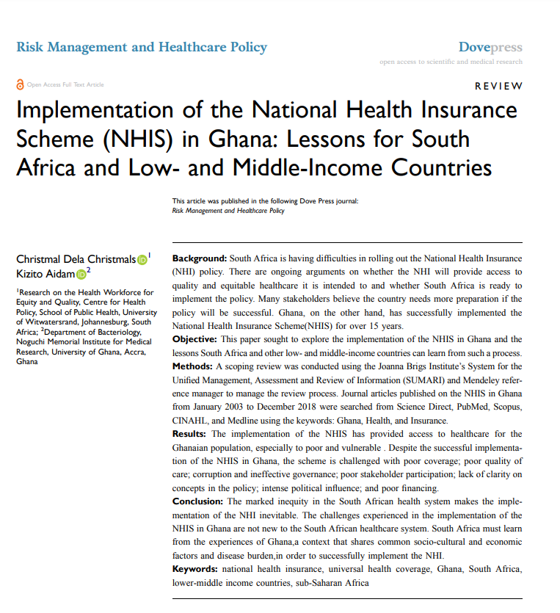
Focus: Accountability

Slide 6
Which of the two is accountable; private or public?

Slide 7
FINANCIAL
PERFORMANCE
political

Slide 8
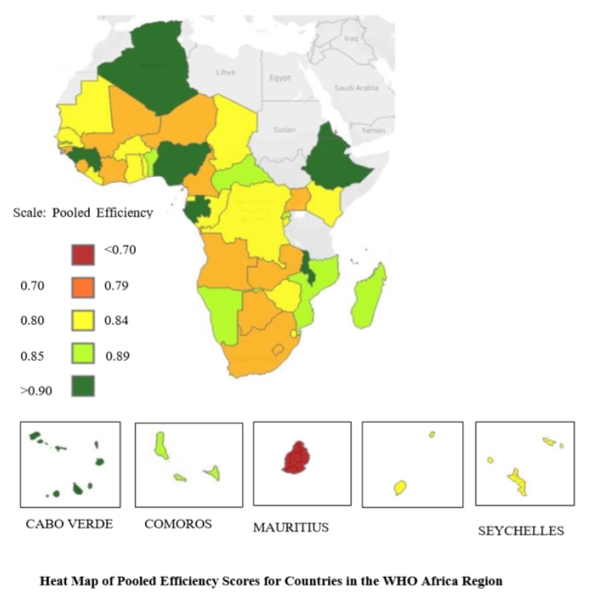
FINANCIAL
Where the focus has always been
Track and report:
Allocation
Disbursement
Utilization of finances
Efficiency

Slide 9
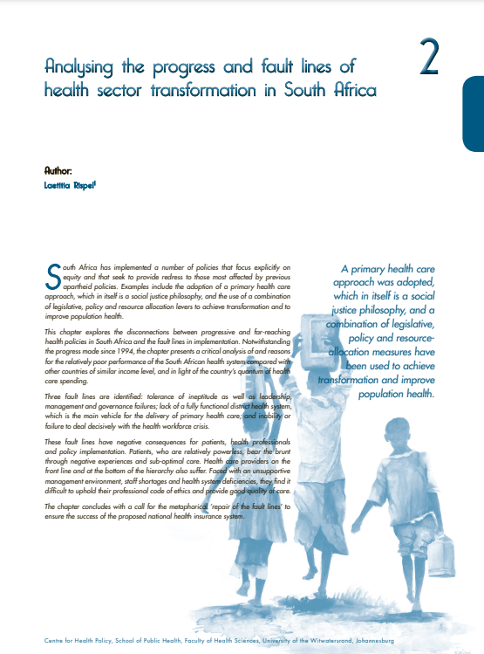
PERFORMANCE
Measured with respect to predetermined targets
Compared to other countries of similar spending, SA is performing poorly in health outcomes

Slide 10
POLITICAL
Institutions, procedures, and mechanisms:
Public trust
Aggregates and
Represents citizens’ interest
Responds to societal needs and concerns

Slide 11
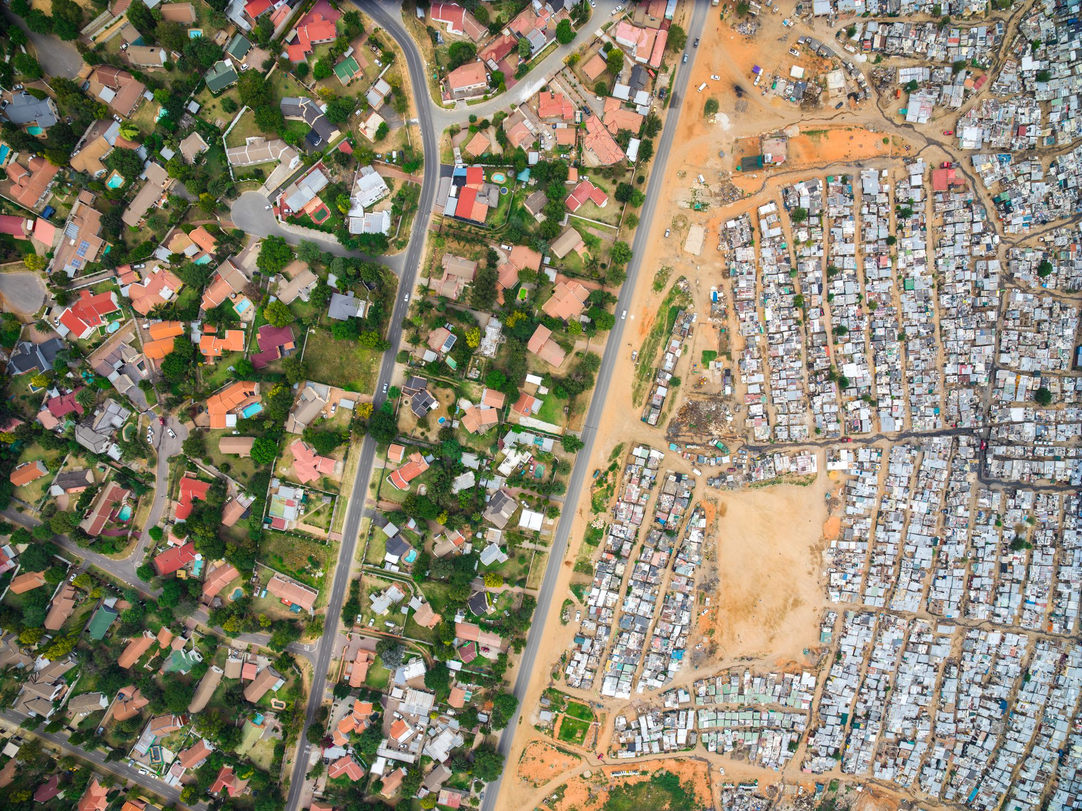
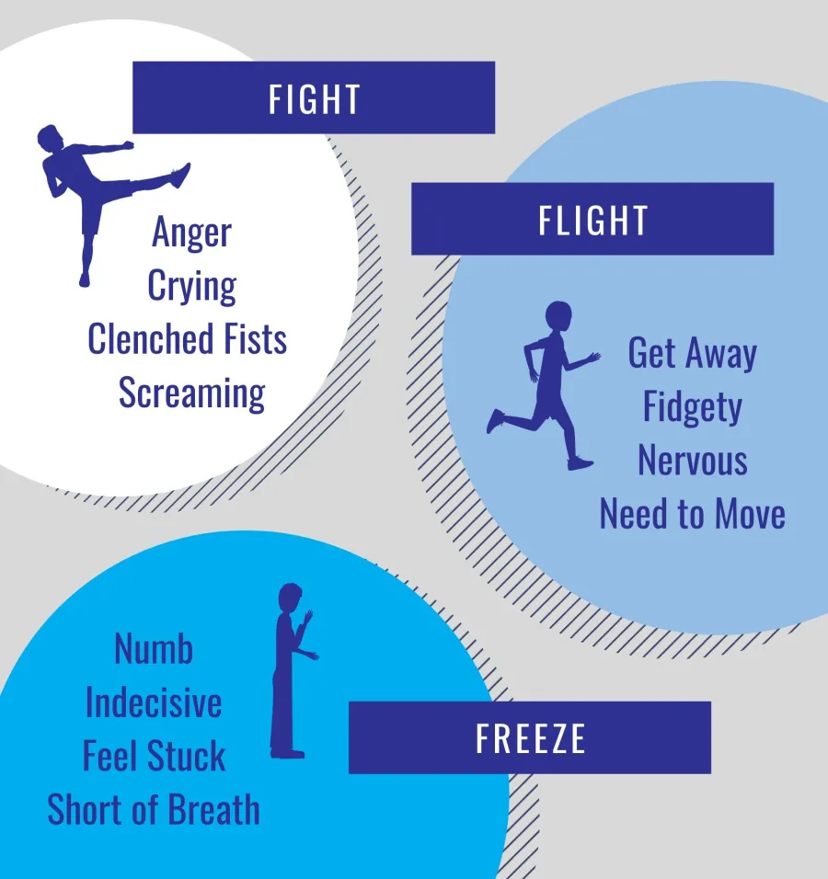
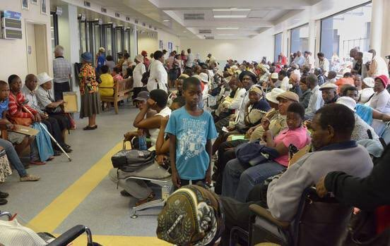
The paradox of accountability in SA NHI
The stable middle class (21%),
The elite (3%)
Vulnerable middle class (15%)
Sources: 1. https://jfs-sa.org/stress-signs/
https://twitter.com/RomanCabanac/status/1204311294913982464
https://sa-tied-archive.wider.unu.edu/article/game-snakes-and-ladders-loaded-dice-socioeconomic-class-and-poverty-south-africa#:~:text=Socioeconomic%20class%20in%20South%20Africa&text=We%20divide%20South%20Africans%20into,middle%20class%2C%20and%20the%20elite.
Chronically poor(48.8%), the transient poor (12%)

Slide 12
1. Partake Intensely in Implementation 2. Critically engage government 3. continually advocate in writing and presentations

Slide 13
Click to donate
https://nhi.healthjusticeinitiative.org.za/

Slide 14
Questions
THANK YOU

