Slide 1
NHI: Transparency, Accountability, Monitoring & Evaluation.
Ronelle Burger
Stellenbosch University

Slide 2
NHI vision
Achieve better health outcomes and promote cohesion, solidarity and social justice in health system
From NHI preamble: “Equitable, effective and efficient utilization of resources in our health system”
Currently inequality in our society mirrored in our deeply divided and polarised health system with enduring health inequalities
e.g. Research (Chao, et al., 2018) shows that in 2016
26 deaths per 1000 live births amongst children under 5 in most affluent wealth quintile (top 20%)
60 deaths per 1000 live births among their peers in the bottom wealth quintile (bottom 20%)

Slide 3
NHI vision
“Of all the forms of inequality, injustice in health care is the most shocking and inhumane” – Dr. Martin Luther King, Jr.
Social justice rationale
Basic right to health care
Poverty trap operating via poor communities having worse access to health care or/and access to worse health care
Growth and efficiency: human capital

Slide 4
NHI vision
Why is accountability crucial to achieving this vision?
Accountability of health systems is a basic right recognized with 1978 Declaration of Alma-Ata & 2018 Declaration of Astana
This entails an active role in
maintaining, promoting and restoring their health
planning, organisation, operation and control of primary health care
Health workers & policymakers appointed to serve citizens
Thus need to be responsive and accountable to those citizens
Principle of good governance
Encourages accountability & needs-responsiveness (people-centred)
Enhances equity & social justice

Slide 5
Accountability and public services
Client
Often no direct link
Weak link via irregular elections
Policy makers
Link through contract and payment Responsiveness to poor depends on contract design and management of contract
Provider
Notes:
Policy makers can make the provider care about the client through well-designed contract. Difficult to design well and manage well but expertise can be contracted in
Bigger problem may be how to make the policy makers care about the client in the first place. Elections not strong punishment mechanism (irregular, limited choice, behaviour/effort of policy makers not well observed and info dependent on quality of media)

Slide 6
Accountability and public services
Principal
Delegating
Agent
Financing
Performing
Informing
Enforcing
Client
Provider
From World Development Report 2004
Notes:
DELEGATING – you have need which you delegate, i.e. want a sandwich and ask take away café to make me one
FINANCING – pay the sandwich shop for this
PERFORMING – they do it
INFORMING – through consuming sandwich
ENFORCING – via repeat business affect profitability (some carrot or stick)
Problem with provider-client relationship – lacking all arrows from right to left
Problem with policy maker –client relationsip –signals not clear/comm/info
Problems with policy maker-provider relationship - INFORMING

Slide 7
How well are our clinics doing on hypertension screening?
Lifestyle advice for controlling hypertension
Hypertension screening
Notes:
1. For this analysis we limit ourselves to the subsample of health worker interactions where patients reported that they tested in the hypertensive stage 1 zone
2. Failed visit: no diagnosis or wrong diagnosis and no follow-up visit recommended
Nurse said whoever sent me to have my blood pressure measured must not have been in their right mind
3-yr old child with serious respiratory issues sent away because of 14h00 meeting by nurses
Facility said they did not have equipment to measure blood pressure Nurse wrote down the BP measurement of 152/84 on piece of paper but provided no diagnosis or consultation because she was too busy
One SP reported 90 patients in the waiting room with one health worker

Slide 8
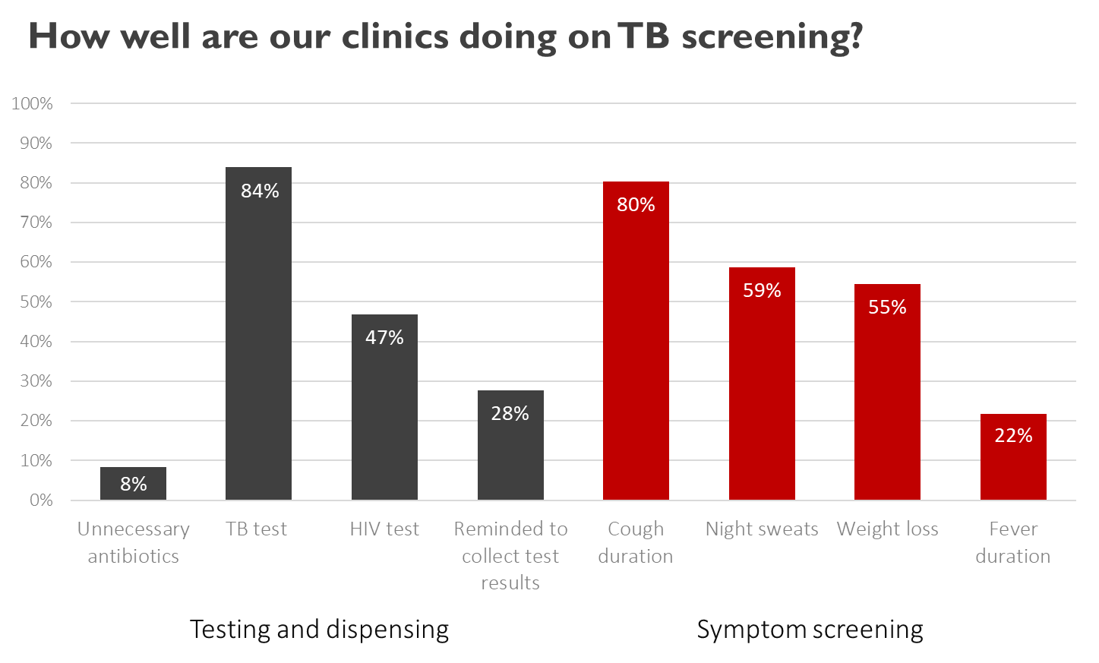
Source: Christian, et al .(2019)

Slide 9
Accountability and information flows in facilities
Percentage of blood pressure screening patients with high blood pressure who are provided with lifestyle advice (e.g. exercise, smoking, diet) at 20 Eastern Cape clinics
Source: Analysis by presenter, 2016 data
Notes:
Question only asked in GHS 2009

Slide 10
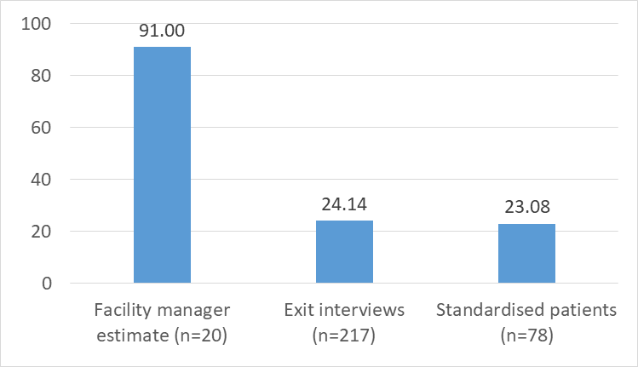
Accountability and information flows in facilities
% of TB testing patients who are offered HIV tests or asked about HIV status: Comparing facility manager assessments of compliance with patient information
Source: Analysis by presenter, 2016 data

Slide 11
Accountability and health in SA
More urgent and pertinent need for enhanced community ownership & provider accountability after era of government corruption and bureaucratic apathy under President Jacob Zuma
Rising number of service delivery protests evidence that communities are disgruntled
Available accountability channels not perceived to be effective (Botes, 2018; Chenwi & Tissington, 2010)
At least three binding constraints to improved accountability
limited devolution of decision-making and power in public health system
citizens’ feelings of disempowerment; low expectations of health providers
lack of timely access to information on local facilities, providers and environmental health local indicators
Notes:
Binding constraints -- conditions that must be remedied or they will delay progress) that impede efforts aimed at making these channels more effective
Devolution of power is crucial for local accountability because hospitals and health facilities cannot be held to account when they do not have authority to deal with citizens’ complaints
Citizens can only make effective use of the available accountability channels if they know their rights, know what they can expect of health services and environmental health standards, and feel empowered to speak out, knowing that their voices matter and can make a difference (Zwama, et al. 2019)
Accountability requires transparency, and accurate and updated local indicators to help communities and patients assess and evaluate local service provision and environmental health (Ebrahim & Weisband, 2007; Potts, 2008).

Slide 12
Health accountability system
rights
CITIZENS
elect to represent and govern
delivery of service
PATIENTS
rights
contractual responsibility
responsibility
GOVERNMENT
PROVIDER
delivery delegated to provider via contract
Notes:
The term “accountability” is now widely used in health policy statements and documents because this concept is universally accepted as essential for good governance. However, the meaning of the term has been diluted through overuse and by imprecise and vague use as a proxy for good governance. The literature on accountability explains the concept as a provider’s obligations to the people who need its services, such as the obligations of a government to the country’s citizens, or a hospital to the patients. The government’s obligation derives from its election by citizens as their representative (the “short arm” of accountability). In the case of medical service providers, the obligation has a more indirect derivation (the “long arm” of accountability). It comes from the government’s appointment of such providers, the providers’ contractual obligation to the government, the government’s obligation to the citizens, and the patients’ health needs. Providers can be contracted via salaried employment or via services rendered for a fee. The important point here is that while the government can contract out the delivery of a service, the responsibility for this service remains the government’s.
This responsibility implies that citizens (in the case of this chapter, patients) have the right to ask the state (the provider) to explain why it made specific decisions and took certain actions. Citizens (patients) can assess and evaluate the decisions and actions of the state (the provider) and use their voice to complain and call for reform, but also to give positive feedback, call for penalties or mobilise communities to demand reforms. Figure 1 illustrates these roles and relationships. In line with the framework proposed by the Lancet Global Health Commission on High Quality Health Systems, we have placed citizens and patients at the centre of this diagram (Kruk & Pate, 2020).
Various institutional accountability support mechanisms can support, enhance and strengthen these accountability relationships. Media reporting can help to assess whether government and providers are meeting their responsibilities and giving prominence to patients’ grievances and reform agendas, making it more likely that their voices will be heard. NGOs play a similar role, but using different channels. Both civil society and the media can make patients aware of their rights and what they can expect (and demand) from providers and the government. The judicial system can enforce accountability in cases where responsibilities and obligations have been acknowledged as legal rights. In South Africa, all three mechanisms have been used well and effectively (Levy, Hirsh, Naidoo & Nxele, 2021; Raith Foundation, 2020; Wasserman, 2020; Heywood, 2009; Pieterse, 2008).
ibid

Slide 13
Health accountability system
JUDICIAL SYSTEM
consequences
Systems that facilitate empowerment of citizens
voice
MEDIA & NGOs
INFORMATION
evaluate & assess
rights
CITIZENS
elect to represent and govern
delivery of service
PATIENTS
rights
contractual responsibility
responsibility
GOVERNMENT
PROVIDER
delivery delegated to provider via contract
Notes:
The term “accountability” is now widely used in health policy statements and documents because this concept is universally accepted as essential for good governance. However, the meaning of the term has been diluted through overuse and by imprecise and vague use as a proxy for good governance. The literature on accountability explains the concept as a provider’s obligations to the people who need its services, such as the obligations of a government to the country’s citizens, or a hospital to the patients. The government’s obligation derives from its election by citizens as their representative (the “short arm” of accountability). In the case of medical service providers, the obligation has a more indirect derivation (the “long arm” of accountability). It comes from the government’s appointment of such providers, the providers’ contractual obligation to the government, the government’s obligation to the citizens, and the patients’ health needs. Providers can be contracted via salaried employment or via services rendered for a fee. The important point here is that while the government can contract out the delivery of a service, the responsibility for this service remains the government’s.
This responsibility implies that citizens (in the case of this chapter, patients) have the right to ask the state (the provider) to explain why it made specific decisions and took certain actions. Citizens (patients) can assess and evaluate the decisions and actions of the state (the provider) and use their voice to complain and call for reform, but also to give positive feedback, call for penalties or mobilise communities to demand reforms. Figure 1 illustrates these roles and relationships. In line with the framework proposed by the Lancet Global Health Commission on High Quality Health Systems, we have placed citizens and patients at the centre of this diagram (Kruk & Pate, 2020).
Various institutional accountability support mechanisms can support, enhance and strengthen these accountability relationships. Media reporting can help to assess whether government and providers are meeting their responsibilities and giving prominence to patients’ grievances and reform agendas, making it more likely that their voices will be heard. NGOs play a similar role, but using different channels. Both civil society and the media can make patients aware of their rights and what they can expect (and demand) from providers and the government. The judicial system can enforce accountability in cases where responsibilities and obligations have been acknowledged as legal rights. In South Africa, all three mechanisms have been used well and effectively (Levy, Hirsh, Naidoo & Nxele, 2021; Raith Foundation, 2020; Wasserman, 2020; Heywood, 2009; Pieterse, 2008).
ibid

Slide 14
Required attributes of health system indicators to enhance accountability
Accountability dimensions | Associated requirements for information and indicators
Assessment and evaluation of provider quality and environmental health | Widely viewed as credible, reliable and accurate
 | Available at regular intervals, enabling tracking over time
 | Timely availability and available at local level to identify facilities that need support at early stage
 | Indicators that allow early identification of health system weaknesses (e.g. child obesity vs higher morbidity/mortality burden 40 years later)
 | For assessing facility effectiveness: Clear measures of facility effectiveness that do not partly reflect community factors
Patients’ voices | Easy to understand and interpret meaning of the indicator
 | Clear why this indicator matters, communities and patient groups intuitively care about it and want to work towards it

Slide 15
Shortfalls re health information systems
Shortcoming shortage of information on health system performance
Very little data available on outcomes
e.g. despite myocardial infarctions being a large part of the country’s disease burden, no public data on how many occur each year, what percentage are fatal and how well hospitals manage them
These shortcomings imply that performance management and planning and policy processes are blind to these dimensions

Slide 16
Shortfalls re health information systems
Need more information on control of chronic diseases
CCMDD data can track dispensing & collection of medication
But need suitable denominator to estimate % of patients diagnosed with hypertension who are on medication
Aggregated data on use of medicines cannot help us to assess
drug adherence
evaluate drug safety
or compare outcomes for different drug treatments
We need longitudinal data to
track patients across system
examine continuity of care and quality of patient management
Also, more detailed data vital for understanding inequalities
Aggregate data can obscure differences at small area level, such as sub-districts or individual facilities

Slide 17
Shortfalls re health information systems
Shortage of data on contribution of social and environmental factors to health outcomes
e.g. education, social development, nutrition, water quality, air quality, sanitation and housing
Crucial to invest in inter-sectoral data systems to promote and deepen understanding of social determinants of South Africa’s burden of disease
Planned revival of Blue Drop and Green Drop reporting systems on water and sewerage respectively
launched in 2009 but disbanded in 2014
44% of water treatment works and 56% of waste water treatment works were classified as not working properly (DWAF, 2019:19)

Slide 18
Achieving the NHI vision
To achieve greater solidarity over the long-term and improve health outcomes need commitment to transparency and incremental improvements
Due to shared yardstick for private and public providers may need to start with few basic measures
Need to ensure that these are reviewed and improved when feasible with aim to move towards facility-level effort-based outcome measures as these can function as engines for quality improvement

Slide 19
Achieving the NHI vision
NHI needs to monitor large number of providers and much of this may be based on self-reported information
Therefore:
Crucial to get communities on board
Activating community engagement channels such as hospital and clinic boards
Mobile surveys of users as part of performance measures?

Slide 20
Important recent innovations in transparency and information
Western Cape Provincial Health Data Centre
Patient-level clinical data linked across two dozen sources of data to enable tracking of patient’s health journey over time
Data used to administer telemedicine service for high-risk patients with co-morbidities (David et al., 2021)
Ritshidze Project
Use data to boost citizen voices to hold government and aid agencies accountable for inadequacies in TB and HIV service delivery
Community-led monitoring system
Quarterly surveys at 400 clinics and community healthcare centres across 27 districts in 8 provinces
Data analysed & problems identified
Solutions explored
Platform for advocating for improved health services in community

Slide 21
Important recent innovations in transparency and information
Stock visibility system
Designed to track availability of medicines
Paired to a smartphone mobile app that can capture and upload information on availability and expiry rates of medicines
Aim is early detection to minimise drug stockouts
Sends staff reminders about weekly stock updates and flags problems
Can also order and receive medicine
Data from this system can assess use of particular medicines
Centralised Chronic Medicines Dispensing & Distribution
Allows stable chronic patients to collect their medication from other points
public health facility express queue
private provider
community-based pick-up points e.g. churches, community halls or Pelebox
Pelebox’s smart locker technology can flag patients who did notcollect their medicine, which facilitates improved patient management

Slide 22
Spare slides

Slide 23
Accountability and health in SA
Post-apartheid South African government introduced reforms to create channels for health system accountability
White Paper for Transformation of Health System in South Africa of 1997
National Health Act 61 of 2003
Despite reforms, system remains centralised and top-down
System does not value and prioritise needs of communities
Impact of hospital boards and clinic committees has been minimal
Schneider et al. (2017) documents complaints about shortcomings of these committees
lack of political commitment
poor participation by facility managers
negative attitudes of health workers
inadequate resources
insufficient capacity and skills of committee members
lack of clarity about the role and mandate of committees

Slide 24
More than 30 social scientists teaming up to collect rapid data
NIDS-CRAM as an innovation to promote transparency and accountability
Notes:
The NIDS-CRAM National Income Dynamics Study Coronavirus Rapid Mobile Survey. Research team was a partnership between more than thirty social scientists from different institutions, along with civil society stakeholders and a broad platform of government partners whose aim was to conduct rapid research to facilitate a targeted, well-designed, and evidence-based response to the pandemic. For me, it was a major honour to be invited to join this group, listing amongst them, many of my long-time heroes in social policy research. People like Leila Patel & Murray Leibbrandt, Haroon Bhorat, and influential policy makers such as Thabo Mabogoane from Department of Planning, Monitoring and Evaluation and Michael Sachs, previously from National Treasury & now at WITS (show slide 2).

Slide 25
Rapid data to provide policy guidance for crisis
NIDS-CRAM
114 days
24 March First conversation about need for evidence on social impact of COVID
Late April Funding
Sampling strategy, survey mode
Contracting provider
Instrument, ethics
May-June
Survey conducted,
Data analysis, Analysis
15 July:
Public release of findings and data
Early April Multi-institutional research team, Support from Presidency, NDOH, Treasury
MATCH
57 days
20 May informal discussions with policymakers
June: Rapid ethics approval,
NDOH approval,
Instrument finalized
Budgets approved, Contract signed, Survey conducted 24 – 30 June
Analysis
15 March + April: LOCKDOWN
May: LEVEL 4
June/July: LEVEL 3
Notes:
For many of us the involvement in this initiative, spearheaded by Nic Spaull, was extremely meaningful because of the overwhelming feelings of helplessness that we all encountered during the intense and stringent lockdown, which we all feared would have severe, deep-cutting and long-term social consequences. Also, the complexity of South African society and expected differential impacts of groups accentuated the need for data to guide government and civil society responses and made representative sampling even more vital. We were fortunate that government responded incredibly well to our initiative, with government policymakers involved in the analysis and requesting private follow-up interactions with our teams following the launch of new data so that they could better understand the consequences of the pandemic and the lockdown and better manage the fallout.
Accomplishing what was considered impossible (show slide 3), the NIDS-CRAM survey was conceptualized, planned, ethically approved, conducted, cleaned, analysed, written up and publicly released in 114 days, During this period, the team obtained approval and support from the Office of the President, the National Department of Health, the National Treasury, and the National Planning Commission; procured funding; recruited a research team; designed a sampling strategy that would ensure a representative sample to capture SA inequality; selected a survey mode that would be appropriate for lockdown period; compiled instruments; contracted a provider to undertake telephone interviews; obtained ethics approval; conducted the surveys; cleaned and analyzed the data, wrote up results, had results peer reviewed, revised results and disseminated the findings, releasing all do files and data so that others can transparently duplicate and validate what we report.
Conversations about this collaboration started as we were going into April-May lockdown, and findings were released in middle July. To put this in perspective, the traditional or average timeframe for accomplishing these tasks would be about three to four years. It meant sleepless nights, it meant that teams were working on documents in parallel; it meant finding new ways to work faster without sacrificing the quality of the work. I assume that many who are gathered here today had similar experiences and memories of that time, helping where they can and finding new ways to solve problems given the urgency and the limitations of the environment. Somehow, being part of this team, and helping to generate this data set and these findings helped to create a sense of agency and purpose amidst overwhelming feelings of vulnerability and helplessness.
The experience of being part of this fantastic team of researchers helped me see the value of data anew. Large sample, quantitative research can enable us to step outside ourselves, to see how the puzzle pieces of our own perspectives and experiences fit into the bigger picture, and this can be very helpful. And, more importantly over the past 16 months, I have developed a renewed respect for numbers and statistics because I have seen how quantitative research can be a torch, how it can shine a light on a problem in a remarkably effective and compelling way, demanding attention and implying a sense of urgency. Some of this is real and pragmatic because it gives us a sense of the contours of the problem and how it manifests amongst specific groups and in specific areas, but there also appears to be a psychological and more enigmatic component to it, which I feel is in many ways similar to the empowerment derived from naming a problem.

